Slide 1
Design Pattern - Structural Patterns
CSCI-630 - Software Design & Maintenance
-Sandesh Sobarad and Abhilash Sreenivasa
Proxy Design Pattern

Slide 2
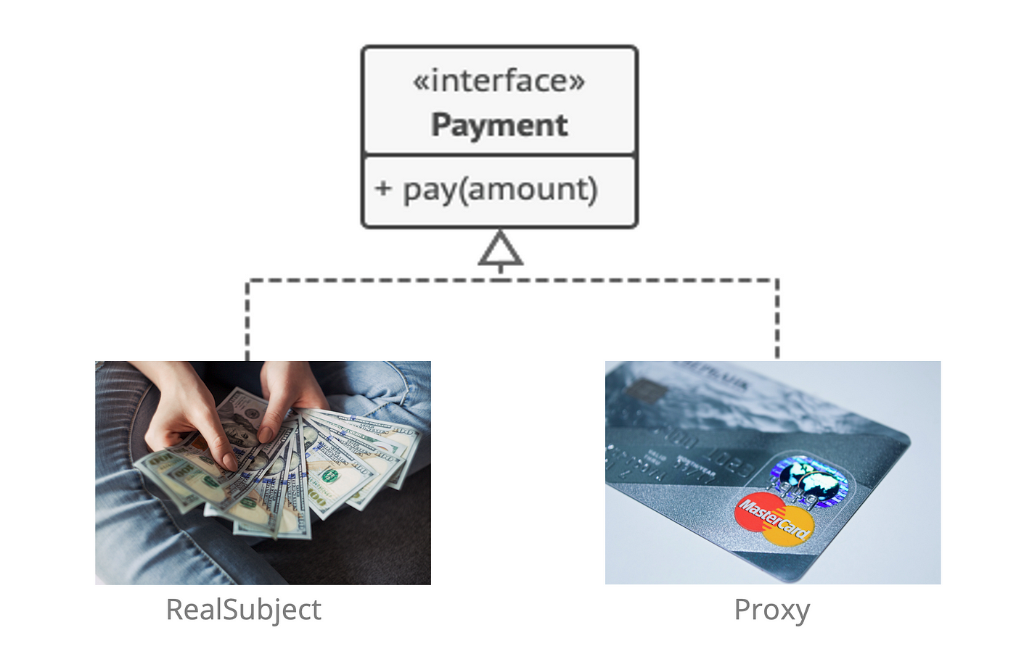

Slide 3
Proxy Design Pattern and its Purpose
The Proxy design pattern is a structural design pattern that provides a surrogate or placeholder object that acts as a representative of another object or adds additional functionality to it.
The purpose of the Proxy pattern is to control access to an object or add additional behavior without modifying its implementation.
The Proxy pattern is commonly used in scenarios where direct access to the real object may not be desirable or possible, or when additional behavior needs to be added to the real object without modifying its implementation

Slide 4
The Proxy pattern applications
Controlling access: The proxy can enforce access control policies by checking permissions or authentication before allowing the client to access the real object.
Adding functionality: The proxy can provide additional functionality or services around the real object.
Optimizing performance: The proxy can cache results of expensive operations and return cached results for subsequent requests.
Simplifying interfaces: The proxy can provide a simplified or specialized interface to the real object, tailored to the needs of the client.

Slide 5
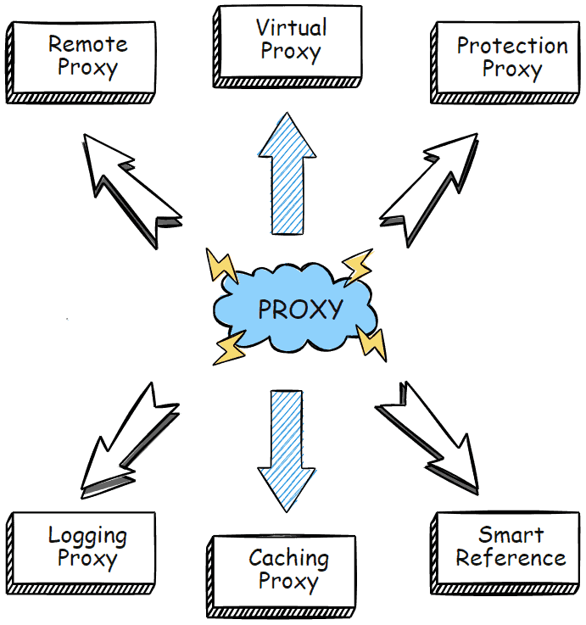

Slide 6
Protection Proxy
Virtual proxies are commonly used for optimizing performance in systems that involve expensive resource creation or retrieval. By delaying the creation or retrieval of resources until they are actually needed, virtual proxies can reduce the initial loading time, memory usage, or computation overhead. Virtual proxies are important for improving performance in resource-intensive systems and enhancing the overall user experience by optimizing resource management.
Real-time Examples:
File System Access
Remote Service Authentication
Payment Processing.

Slide 7
Remote Proxy
In modern distributed systems, remote proxies are commonly used to communicate with remote services, APIs, or databases. They provide a local representation of the remote object, allowing the client to interact with it as if it were a local object, abstracting the complexities of network communication and protocols. Remote proxies are important in enabling seamless integration with remote resources, facilitating remote method invocations, and managing remote resource access.
Real-time Examples:
Remote API calls
Cloud Storage
Database Connectivity

Slide 8
Pros and Cons of Proxy Design Pattern
Pros | Cons
Improved Performance | Increased Complexity
Enhanced Security | Reduced Transparency
Simplified Client Code | Overhead
Lazy Initialization | increased code duplication

